Slide 1

LIFE EXPECTANCY ANALYSIS
Bhaargav Nath (09A)
Puneet Kumar (23A)

Slide 2
About Dataset
The dataset related to life expectancy, health factors for 193 countries has been collected from WHO data repository website and its corresponding economic data was collected from United Nation website. Among all categories of health-related factors only those critical factors were chosen which are more representative. The goal of this project is to build a Linear Regression Model to predict the likelihood of Life Expectancy in different countries of the world. The link to original dataset can be found here.

Slide 3

DATASET
This dataset consists of 2938 rows and 22 columns.
Dependent variable life expectancy
2 categorical variable and all other are continuous variable

Slide 4
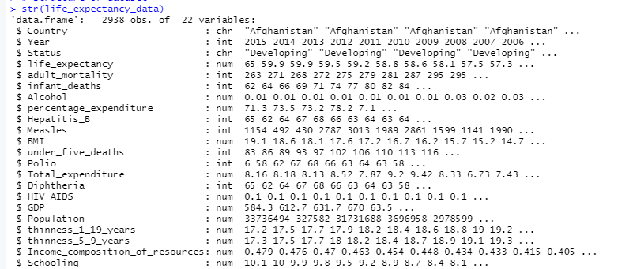
Glimpse of Data (Life Expectancy)

Slide 5
Objective
How the life expectancy is being affected by the other features present in the dataset?
What are the features that are significantly affecting the life expectancy?
Response Variable: Life expectancy (in years)
Predictor Variables: Adult mortality, Infant deaths, Alcohol, Total expenditure, Hepatitis B, Measles, BMI etc.

Slide 6
DATA PRE - PROCESSING
MANY VARIABLES HAS MISSING VALUE , WE HAVE FILLED THE MISSING VALUE THROUGH MEAN TO AVOID ERRORS IN ANALYSIS
There might be a few outliers when estimating life expectancy that we should overlook. Outliers must be found since they raise error variance and lower the power of statistical tests. They might skew results or have an impact on projections. They may also influence the fundamental premise of regression and other statistical models.

Slide 7
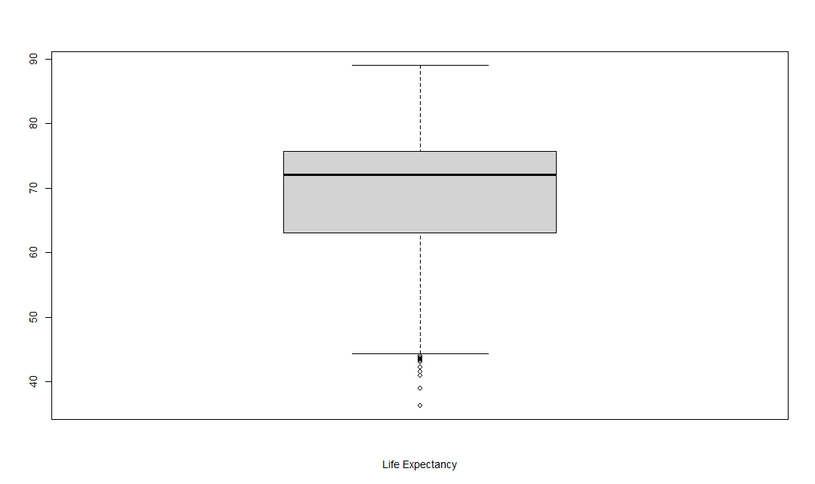
Boxplot (Life Expectancy)
Mean life expectancy is around 70 years.
Median life expectancy is round 72 years
50% of the data is between 62-78 years.
Minimum life expectancy is 36.30 years.
Maximum life expectancy is 89 years.

Slide 8

GRAPHICAL ANALYSIS
Scatter plots are frequently used to identify any relationships between data since they make it simple to see any correlation.

Slide 9
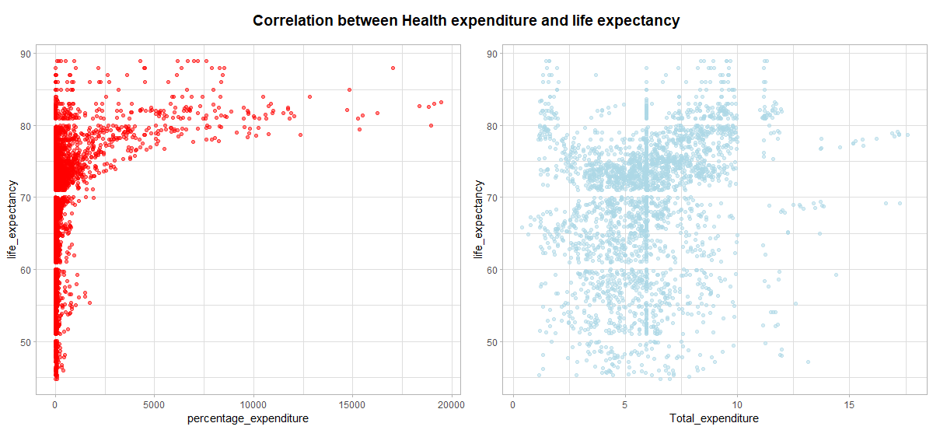
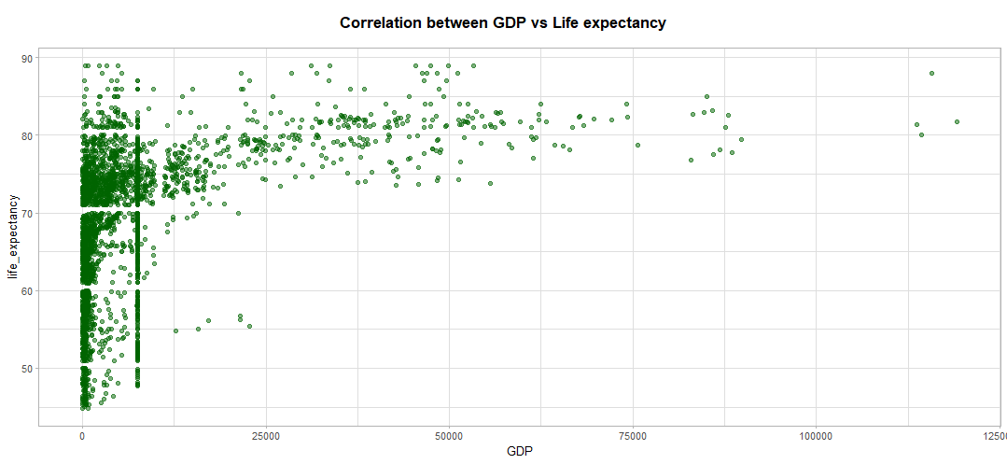
Coorelations
According to the graph, the concentration of life expectancy increases when spending ranges between $5,000 and $20,000.

Slide 10
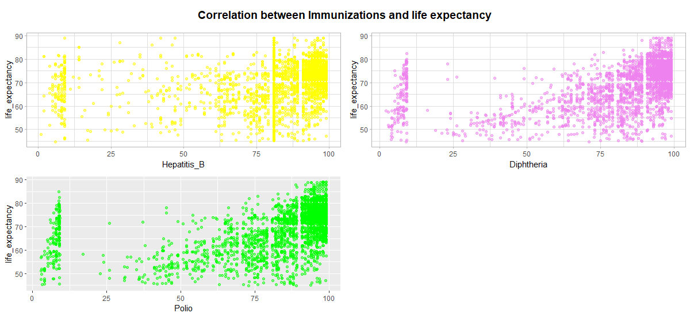
Coorelations
Data points for Hepatitis B and diphtheria vaccinations are concentrated in people between the ages of 60 and 80, therefore getting immunised is unquestionably beneficial for a longer life expectancy.

Slide 11
Coorelations

Slide 12
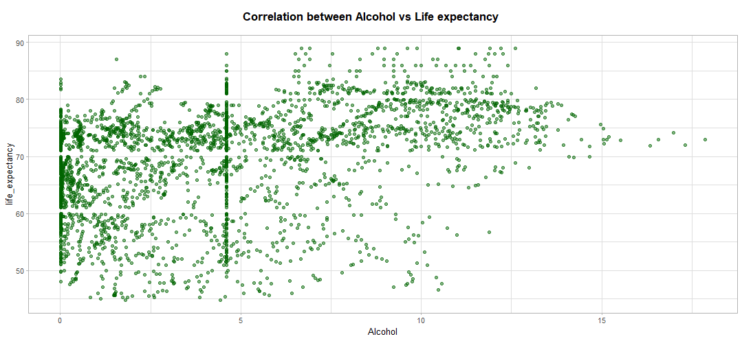
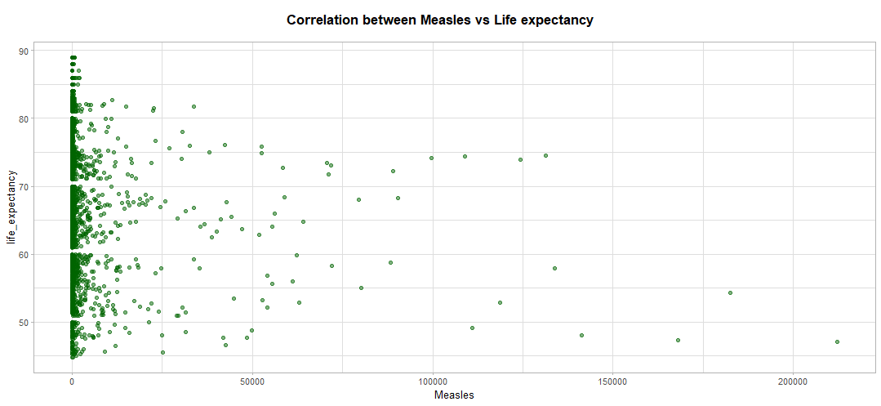
Coorelations
We can observe that there are different numbers of reported cases of measles in each age group, ranging from 0 to 50k. Additionally, we may detect various numbers between 50k and 250k that could have affected life expectancy.

Slide 13
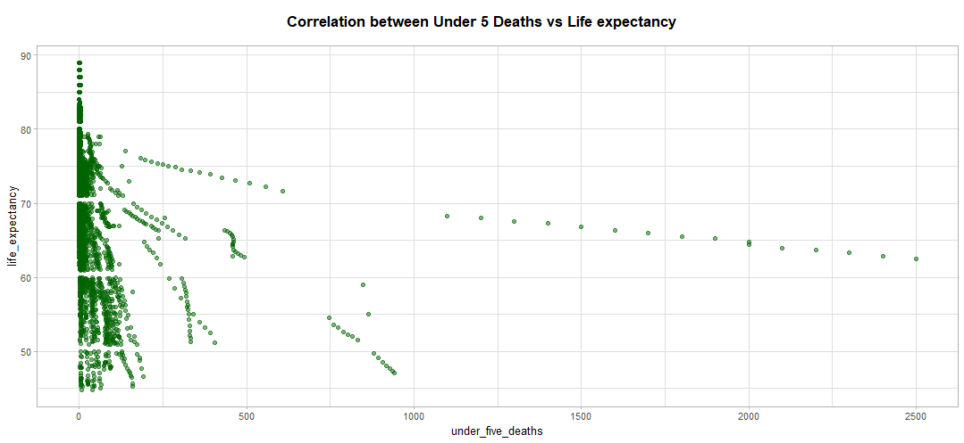
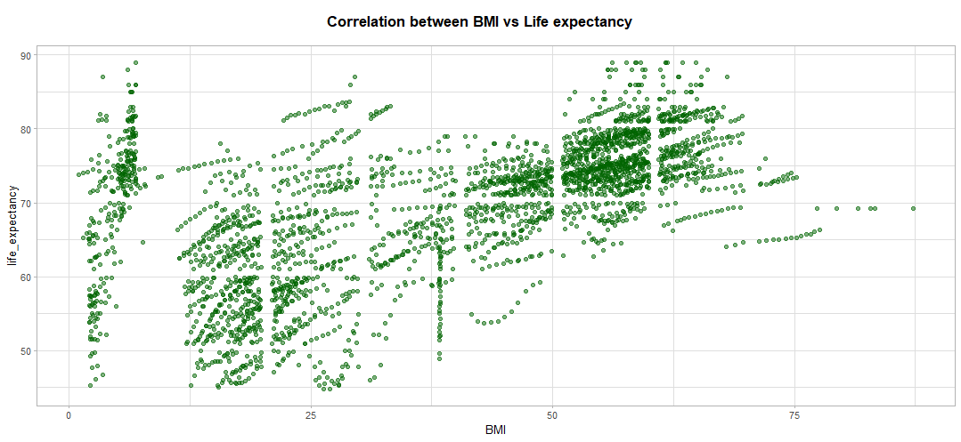
Coorelations
We can see that life expectancy of the population decrease as the BMI increase.

Slide 14
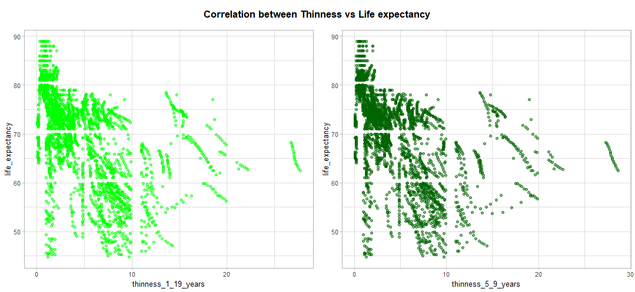
Coorelations

Slide 15
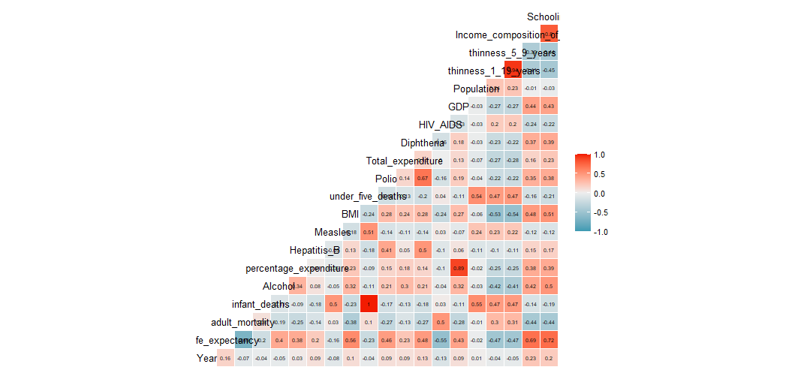
Correlation between independent numerical variables and the dependent variable
The Life Expectancy variable is found to be strongly positively correlated with education and Income.composition.of.resources. Adult.Mortality, on the other hand, has a substantial negative association with Life.Expectancy, which is a reasonable conclusion because when adult mortality is high, life expectancy would undoubtedly be low.

Slide 16
Regression Analysis:
The goal of linear regression is to mathematically represent a continuous variable Y as a function of one or more variables X, allowing us to use this regression model to predict the Y when only the X is known.
Initial Linear regression model.
Outcome: Life Expectancy (reasons for high or low life expectancy?)
Predictors: Alcohol, Percentage Expenditure, Hepatitis B, Measles, BMI, Under Five Deaths, Polio, GDP, Total Expenditure, Diphtheria, thinness 1-19.years, thinness5-9.years, Income composition of resources

Slide 17
Regression Analysis:
Residual standard error: 5.851 on 2323 degrees of freedom
Multiple R-squared: 0.6226, Adjusted R-squared: 0.6205
F-statistic: 294.8 on 13 and 2323 DF, p-value: < 2.2e-16
As observed in our example, the F-p-value statistic's is 2.2e-16, which is quite significant. This indicates a meaningful relationship between at least one of the predictor variables and the outcome variable.
We may look at the coefficients table, which displays the estimated regression beta coefficients and the accompanying t-statistical p-values, to determine whether predictor variables are significant:
It's fascinating to observe how all other factors, including alcohol, vaccinations (against polio and diphtheria), body mass index (BMI), and human development, affect life expectancy.

Slide 18
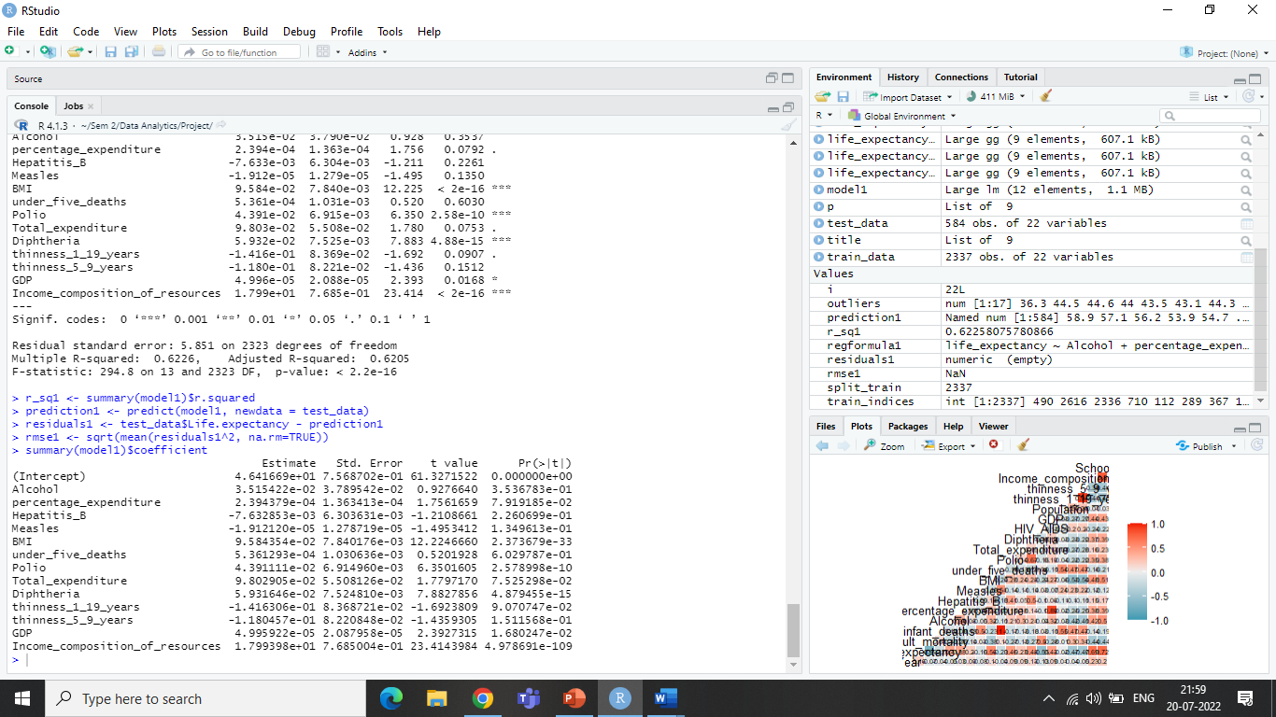
Coefficient:

Slide 19
Model Evaluation:
Diagnostic Plots are used to assess the model assumptions and determine whether any observations have the potential to significantly affect the results.
The distance that the data points are from the regression line is measured by residuals. When you enter values for the predictors, factor levels, or component values into the model, fitted values are models' predictions of the mean response value.

Slide 20
Final Model:
Final model can be written as follow:
Life_Expectancy = β + β1 x Alcohol + β2 x Diphtheria + β3 x BMI + β4 x Polio + β5 x Total_expenditure + β6 x thinness_1_19.years + β7 x Income_composition_of_resources

Slide 21
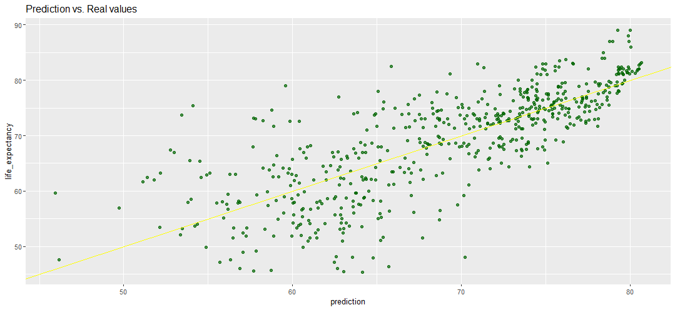
Prediction vs Real values

Slide 22
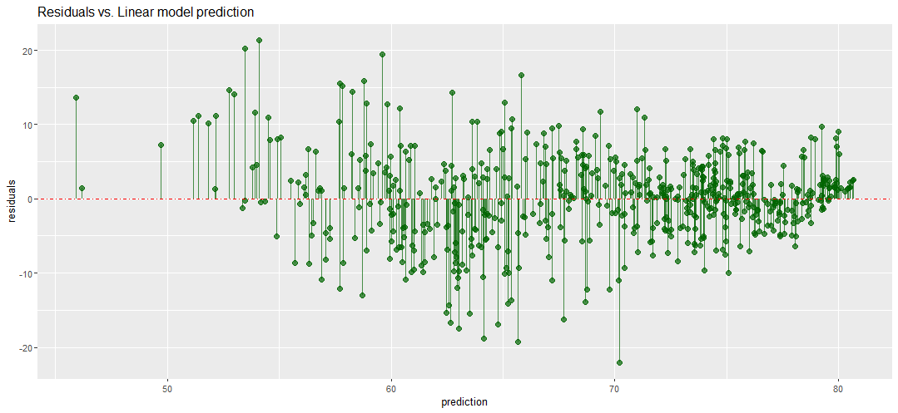
Residuals vs Linear Model Prediction

Slide 23
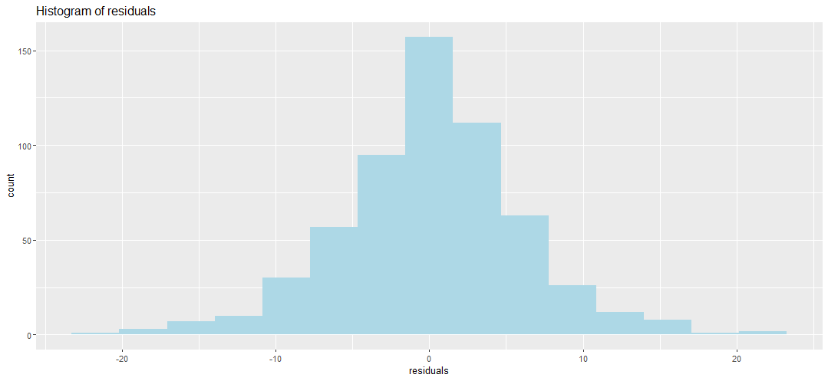
Histogram

Slide 24
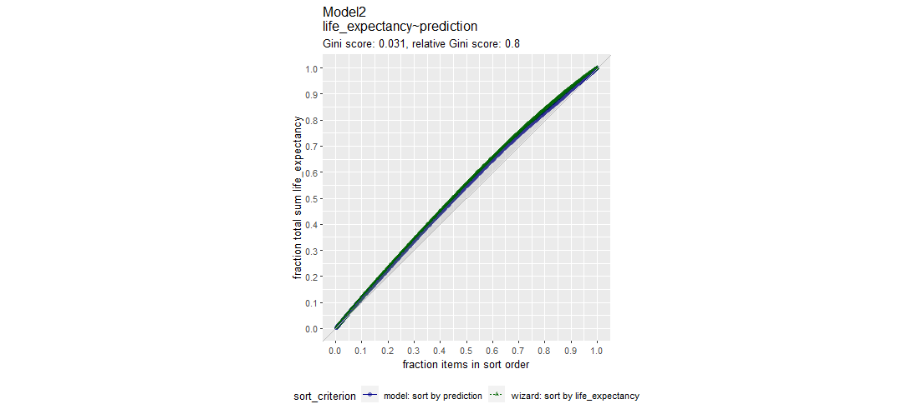
Model Prediction

Slide 25
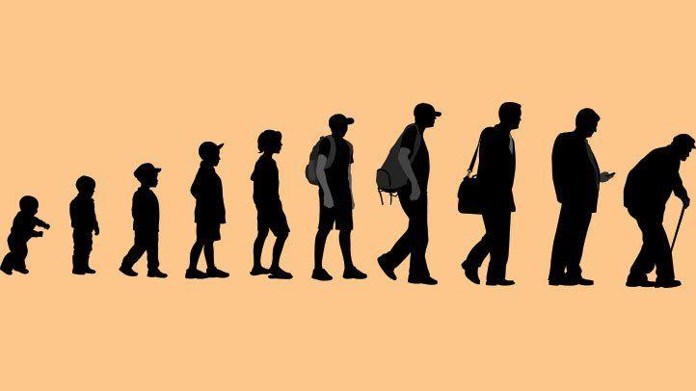
INSIGHTS
Reaching 15 years of age does not ensure a good life while schooling does
A country's GDP and income composition affect life expectancy more broadly
One can extend their life span by adopting a healthy lifestyle, having proper BMI, proper schooling, and immunization

Slide 26

The aforementioned findings suggest that getting immunised has a strong likelihood of extending life expectancy. We were able to accomplish the goal and identify variables that are crucial to the development of a life expectancy prediction model that businesses and consumers may use. A data set with more features will produce results that are more accurate.

